Slide 1


Kaggle
VSB Power Line Fault Detection
Notes:
Recommending picking out he most interesting and important parts from your documentation.

Slide 2
Agenda
Background
Summary
Feature selection & engineering
Training methods
Important findings
Simple model

Slide 3
Background
Machine Learning Researcher
  Nymi Inc, Intel Corp, CognoVision Inc
  PhD in CS from Univ. of Toronto
ML/Data Science experience
  Computer Vision
  Bio-signal pattern recognition

Slide 4
Summary
Classifier: XGBoost (tree based)
Features: Pyramidal and multi-scale LBP
Artificial training sample expansion
Key aspects:
  Large number of exhaustive features
  Slow feature learning using XGB
Main tools: Python 3.x, XGBoost, Numpy, Numba, Pandas
Notes:
Example dot points
Most important classifier was XGBoost
The three most important features were car color, make of the car, number of miles
One of my biggest insights was that building a separate classifier for each brand of car gave me a big performance improvement
Used Python (Pandas and XGBoost)

Slide 5
Features Selection / Engineering
1-D Multi-scale Local Binary Pattern (LBP)
8-bit words
6 scales
5 Pyramidal signal segments
3 Amplitude difference thresholds
Concatenated 3 phases
Overall, a large, exhaustive feature set:
2^8 x 6 x 5 x 3 x 3 = 69,120 dimension
Notes:
Example dot points
Most important classifier was XGBoost
The three most important features were car color, make of the car, number of miles
One of my biggest insights was that building a separate classifier for each brand of car gave me a big performance improvement
Used Python (Pandas and XGBoost)

Slide 6
LBP Feature Visualization
Features Selection / Engineering

Slide 7
Feature Importance Plot
Features Selection / Engineering

Slide 8
Leaderboard Score Milestones
Features Selection / Engineering
LB Score | Classifier | Feature | Signal Phase
0.075 | Adaboost | Basic LBP | Separate
0.396 | Adaboost | Multi-scale LBP | Separate
0.479 | Adaboost (1000 trees) | Multi-scale LBP | Separate
0.576 | XGB (20K trees) | Multi-scale LBP | Combined
0.518 | XGB (12.6K) | Multi-scale LBP (15K dim) | Combined
0.532 | XGB (25K) | Multi-scale Pyr LBP (65K) | Combined

Slide 9
Training Methods
XGBoost: large number of learners (25,000)
Handling overfitting
  eta = 0.001
  subsample = 0.5 (data subsample)
  colsample_bytree = 0.5 (feature subsample)
  Some grid search
Training class balancing: perturbed features

Slide 10
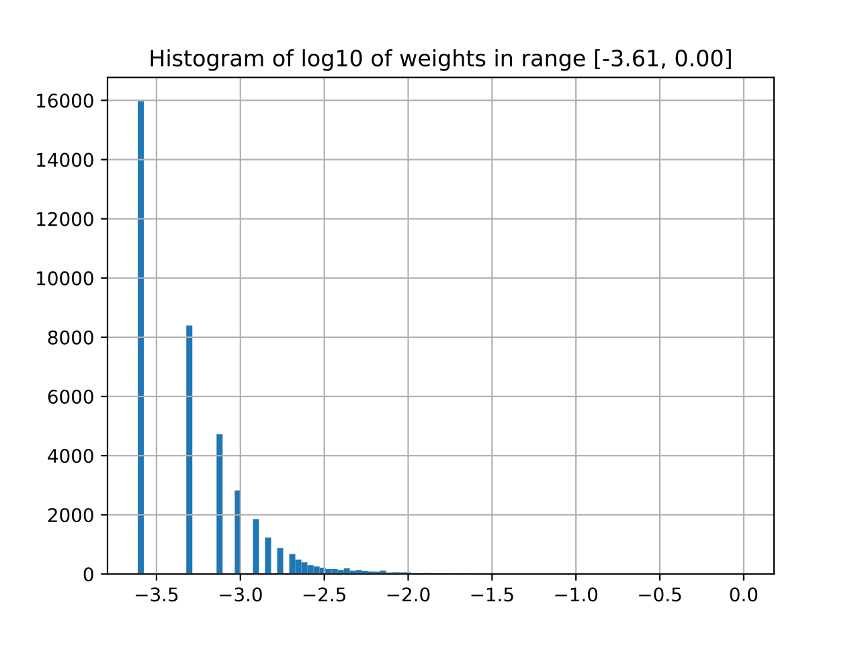
Most Features with Low Weights
Important and Interesting Findings

Slide 11
Observations on Top 20 Features
Important and Interesting Findings
Amplitude difference below 8 is insignificant
Both small and large scale shape features are important (from 8 to 256)
Features are spread across the entire signal

Slide 12
Simple Model
Lower feature dimension:
  Word length: 8
  Radius: 6
  Delta: 8
  Window bounds: entire signal at once
Small XGB learner count: 1000-5000 learners
  Other option: adaboost with 500 learners

Slide 13


Slide 14
Feature Details
Wt | Phase | Segment | Delta | Radius | Word
4089 | 1 | Last ¼ | 8 | 256 | 00001111
2469 | 2 | First ¼ | 8 | 8 | 01001101
1936 | 2 | First ¼ | 8 | 8 | 10101101
1369 | 1 | Full | 8 | 128 | 00110111
1300 | 1 | First ¼ | 8 | 32 | 00101011
1004 | 1 | Last ¼ | 8 | 128 | 00110111
881 | 0 | Full | 8 | 8 | 00000010
832 | 2 | First ¼ | 8 | 256 | 10001101
688 | 1 | Full | 8 | 8 | 11100010
683 | 0 | First ¼ | 8 | 8 | 10101111

